Slide 1


Nipun Varshneya April 2, 2025

Slide 2
Outline
Executive Summary
Introduction
Methodology – Data collection and analysis
Results
Insights from EDA – charts and queries
Launch Site Analysis
Dashboard
Predictive Analysis – pipeline analysis
Conclusion
Appendix
page 3
page 4
page 5
page 19
page 20
page 37
page 40
page 44
page 48
page 49
2

Slide 3
Executive Summary
SpaceX is a private company that designs, manufactures and launches advanced rockets and spacecraft. The company can achieve a significant competitive advantage by salvaging its stage one rocket for reuse in future launches.
In this report we will determine whether the first stage rocket of the Falcon 9 Launch program is recoverable to confirm
SpaceX’s competitive advantage in the private space launch industry.
To confirm our conclusions, we will perform extensive data collection and analysis using past launch data provided by SpaceX REST API and other information from Wikipedia.
Data will be evaluated by reviewing the rocket type used, launch location, payload size, and specific information concerning the characteristics of the specific rockets
This data will evaluate to what extent rocket configuration contributes to launch and landing success, considering whether the core is reused, whether gridfins are used and to what extent legs and the landing pad contributed to success
Summary of results:
Overall landing success occurs in approximately two thirds of launches. This includes, ocean, landing pad and drone landings
Successes have improved as the program has evolved
Payload and orbit have a strong impact on success
The Decision Tree Classifier achieved the highest model accuracy
3

Slide 4
Introduction
SpaceX rocket launches are advertised at a cost of $62mm compared to competitors that have costs of up to $165mm, far exceeding the expected cost of a SpaceX launch
The significant cost advantage derives from the success of reusing the Stage 1 rocket of the launch program
To evaluate the success and effect of salvaging the Stage 1 rocket we will need to review the overall trends of successful launches and how their launch location, payloads and rocket features contribute to success or failure
Specifically, we will need to answer he following questions:
How often do the rockets crash or fail to land?
Does the launch location contribute to success or failure?
Do mission parameters such as payload, rocket orbit, or customer considerations impact recovery of the first stage
4

Slide 5

Section 1
5

Slide 6
Methodology
Data collection:
Comprehensive data was collected from public sources: SpaceX REST API on Github and
webscraping Wikipedia data
Data wrangling:
Data was downloaded from the API and normalized in a .JSON format for further processing. This was combined with data scraped from Wikipedia’s HTML page and converted to table form using BeautifulSoup
Perform exploratory data analysis (EDA) using visualization and SQL
Perform interactive visual analytics using Folium and Plotly Dash
Perform predictive analysis using classification models:
A Machine Learning Pipeline was created to determine whether the first stage Falcon 9 will land successfully. Evaluation using Logistic Regression, Support Vector Machines, Decision Tree Classifier and K-Nearest Neighbors were used to establish model accuracy.
6

Slide 7
Data Collection – SpaceX API
SpaceX API data was collected from a Github repository: https://github.com/r-spacex/SpaceX-API
Three main databases were used to obtain the necessary information for analysis. These .JSON databases included details regarding rocket physical characteristics and historic launch details.
Three main databases were used to obtain the necessary information for analysis. These .JSON databases included details regarding rocket physical characteristics and historic launch details and integrated with scraped and CSV data.
Data was extracted using identification numbers in the launch dataset for specific items:
Booster Version data from ‘rocket’ for rocket ID
Launch Site data from ‘launchpad’ including site location, latitude and longitude
Payload data from ‘payloads’ for size of payloads and orbit information
Core data from ‘cores’ including landing success, landing pad, whether gridfins or legs were used and
whether the core was reused
7
Continued......

Slide 8
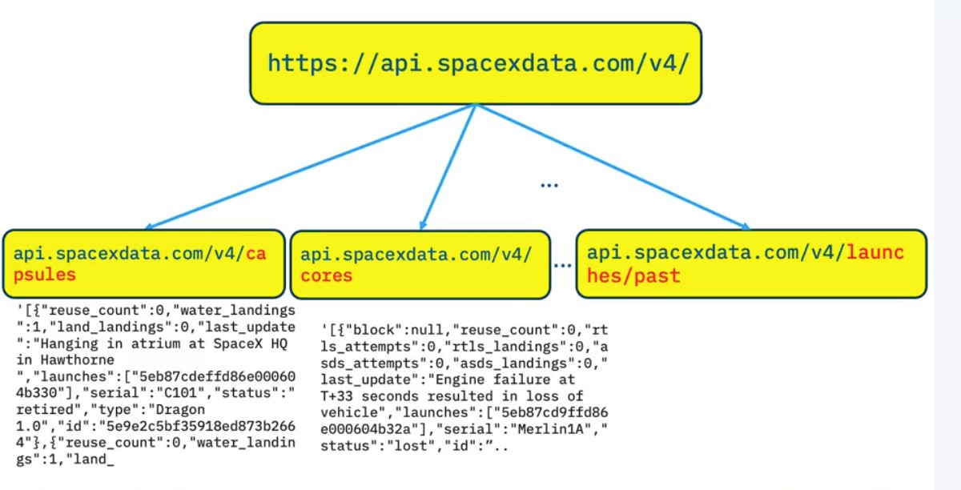
Data Collection – SpaceX API
Past Launch Data:
Spacex_url=https://api.spacexdata.com/v4/launches/past
Booster Version:
response = requests.get(f”https://api.spacexdata.com/v4/rockets/{rocket_id}”)
Launch Site:
response = requests.get(f”https://api.spacexdata.com/v4/launchpads/{launchpad_id}”)
Payload Data:
response = requests.get(f”https://api.spacexdata.com/v4/payloads/{payload_id}”)
Core Data:
response =
requests.get(f”https://api.spacexdata.com/v4/cores/{core[‘core’]}”)
Link to Github Notebook for the API:
https://github.com/Stickman11-99/SpaceX-Analysis/blob/SpaceX-API/jupyter-labs-spacex-data-collection- api.ipynb

Slide 9
Data Collection – Web Scraping
Falcon 9 and Falcon Heavy Launches was scraped from Wikipedia: https://en.wikipedia.org/wiki/List_of_Falcon_9_and_Falcon_Heavy_launches
Scrape Wikipedia for HTML SpaceX data using ‘requests.get(static_url)’
Extract column names and tables using BeautifulSoup
Create a DataFrame by parsing HTML tables and append data to a dictionary “launch_dict”. Finally creating a dataframe from the Dictionary and saving to a .csv file with the following columns:
Continued......

Slide 10
Data Collection – Web Scraping
Launch records are stored in an HTML table on Wikipedia:
static_url=“https://en.wikipedia.org/w/index.php?title=List_of_Falcon_9_and_Falco n_Heavy_launches&oldid=1027686922”
response = requests.get( Static_url )
Web Scraping
Falcon 9 launch records were extracted using BeautifulSoup and converted into a Pandas DataFrame:
soup = BeautifulSoup(response.text, 'html.parser’) html_tables = soup.find_all('table', class_='wikitable’) first_launch_table = html_tables[2]
Use request.get to
collect data
Create Beautiful Soup Object
expected_columns = ['Flight No.', 'Date', 'Time', 'Version Booster', 'Launch site', 'Payload', 'Payload mass', 'Orbit', 'Customer', 'Launch outcome', 'Booster landing’] launch_dict = {key: [] for key in expected_columns}
Extract column names
df= pd.DataFrame(launch_dict)
Create Dataframe ”launch_dict”
Link to Github Notebook for Web Scraping:
https://github.com/Stickman11-99/SpaceX-Analysis/tree/SpaceX-Webscraping

Slide 11
Data Wrangling
Datasets were sampled to confirm data accuracy and conformity
Null values were identified and in the case of Payload Mass were replace by mean values. Landing Pad null values were retained
Data was standardized specific fields created
For rocket landings there are several different outcomes for landings, which are distinguished by landing site, landing pad and drone.
Data Wrangling
Dataset sampled, standardized and null values were addresses
Calculate Launch numbers by Launch Site
Separate the launches by site:
launch_counts = df['LaunchSite'].value_counts()
Determine the number and occurrence of each orbit:
orbit_counts = df['Orbit'].value_counts()
Determine the number of landings outcomes by type: landing_outcomes = df['Outcome'].value_counts()
Determine landing outcomes as successful = 1 and unsuccessful = 0 df['Class'] = df['Outcome'].apply(lambda x: 0 if x in bad_outcomes else 1)
Calculate the number and occurrence of each orbit
Calculate the number and occurrence of each orbit
Link to GitHub Notebook for Data Wrangling: https://github.com/Stickman11-99/SpaceX-Analysis/tree/SpaceX-Data- Wrangling
Create a landing outcome label
11

Slide 12
EDA with Data Visualization
A number of charts were used to establish relationships between various variables to establish success patterns for first stage recovery:
Flight Number vs Launch Site:
This scatter plot illustrates the use frequency and success or failure for each launch site
Payload Mass vs Launch Site:
This scatter plot illustrates the influence payload mass has on success or failure for each launch site
Success Rate vs Orbit Type:
This bar chart illustrates the degree to which orbit type has an influence on success rates
Payload Mass vs Orbit Type:
This scatter plot specifically identifies which orbit types had the most success and whether success is impacted by payload
Launch success by Year:
This line chart shows the success trend by year
Link to GitHub Notebook for Data Visualization:
https://github.com/Stickman11-99/SpaceX-Analysis/tree/SpaceX-EDA-with-Data-Visualization
12

Slide 13
EDA with SQL
A table SPACEXTABLE was extracted from a DataFrame created with Spacex.csv and queries performed as follows:
Display the unique launch site names
Display records for the ‘CCA’ launch sites
Display total payload mass for NASA launches
Display average payload mass for booster F9 v1.1
List the date for the first successful ground pad landing
List the successful drone ship boosters with payloads between 4000 kg and 6000 kg
List mission outcomes buy success or failure
List names of Booster Versions carrying the maximum payload
For 2015 list month names for landing failures in drone ship by Booster Version and Launch Site
Rank landing outcomes between the dates 2010-06-04 and 2017-03-20
Link to GitHub Notebook for EDA with SQL:
https://github.com/Stickman11-99/SpaceX-Analysis/tree/SpaceX-EDA-with-SQL

Slide 14
EDA and Feature Engineering
Exploratory Data Analysis was performed on the data through analysis and visualizations
Preliminary insights have established the importance of each variable and how they impact the success rate:
features = df[['FlightNumber', 'PayloadMass', 'Orbit', 'LaunchSite', 'Flights', 'GridFins', 'Reused', 'Legs', 'LandingPad', 'Block', 'ReusedCount', 'Serial’]]
Dummy variables are used to replace categorical columns using OneHotEncoder. This will allow casting all numeric columns to a ‘float64’ value for further analysis
features_one_hot = pd.get_dummies(features, columns=[‘Orbit’, ‘LaunchSite’, ‘LandingPad’, ‘Serial’])
features_one_hot = features_one_hot.astype(;float64’)

Slide 15
Interactive Analytics with Plotly Dash
The dashboard provides the following interactive elements and insights:
Pie chart: Success count by site:
Compares the success rates for each launch site – provides insight into whether location is impactful
Scatter plot: Payload vs Outcome with range slider:
Provides context to payload and its contribution to success rate for each launch site by Booster Version
Link to Github Notebook for Web Scraping:
https://github.com/Stickman11-99/SpaceX-Analysis/tree/SpaceX-Dashboard

Slide 16
Build an Interactive Map with Folium
Launch success depends on many factors including launch site, payload and orbit. An optimal launch site will improve the success of a launch
In this analysis we have marked launch sites on an interactive folium map and marked the success and failure of launches in the following steps:
Each launch site and NASA’s Johnson Space Center has been marked on the map by latitude and
longitude along with a circle object and a label
Markers were added to each launch site as a ‘MarkerCluster’ identifying each launch from that site in
green for success and red for failure
Mouse position in latitude and longitude was added to the map for further reference
A function has been added to calculate the distance between two points on the map. This allows us to draw a line and determine the distance from the launch sites to any important geographical markers
Link to GitHub Notebook for Interactive Folium Map:
https://github.com/Stickman11-99/SpaceX-Analysis/tree/SpaceX-Folium-Map

Slide 17
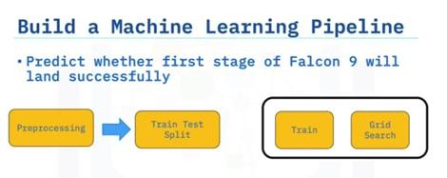
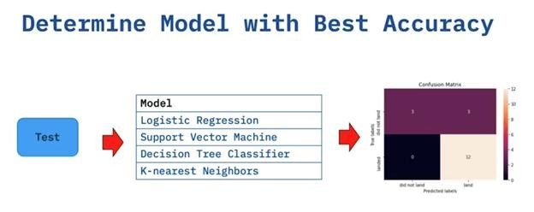
Predictive Analysis (Classification)
Model data was used to create a ‘Class” array and converted to a Pandas series:
Class_array = data['Class'].to_numpy()
Y = pd.Series(Class_array, name = "Class")
Data was then transformed using ‘StandardScaler; to prepare the data pipeline analysis:
transform = preprocessing.StandardScaler()
X = transform.fit_transform(X)
Data Split for training and test purposes:
X_train, X_test, Y_train, Y_test = train_test_split(X,Y, test_size = 0.2, random_state = 2)
continued......
17

Slide 18
Predictive Analysis (Classification)
Four models were used to evaluate the data:
Logistic Regression (lr):
logreg_cv = GridSearchCV(lr, parameters, cv = 10) logreg_cv.fit(X_train, Y_train)
Predictive Analysis
Create Panda’s series and transform using
StandardScaler
Support Vector Machine (SCM):
svm_cv = GridSearchCV(svm, parameters, cv = 10) svm_cv.fit(X_train, Y_train)
Decision Tree Classifier (tree):
tree_cv = GridSearchCV(tree, parameters, cv = 10) tree_cv.fit(X_train, Y_train)
K-Nearest-Neighbors (KNN):
knn_cv = GridSearchCV(KNN, parameters, cv = 10) knn_cv.fit(X_train, Y_train)
Split data into training and testing sets
Perform classification analysis using each of the models
Model accuracy was tested for each model: (Decision Tree used as an example)
print("tuned hpyerparameters :(best parameters) ",tree_cv.best_params_)
print("accuracy :",tree_cv.best_score_)
All models were represented with Confusion Matrix
Test model accuracy
Create Confusion Matrix
Link to GitHub Notebook for Predictive Analysis:
https://github.com/Stickman11-99/SpaceX-Analysis/tree/SpaceX-Predictive-Analysis
18

Slide 19
Results
Exploratory and visual data analysis results reveal that overall success rate has increased as the number of missions has increased.
Launch site CCAFS SLC 40 has had the highest volume of launches with a mixed success rate
Most launches have had payloads below 10,000 kg with launch sites VAFB SLC- 4E and KCS LC-39A having the highest success rates.
Orbits ES-L1, HEO, GEO and SSO have the overall highest success rates
Predictive analysis shows that the Decision Tree model has the highest accuracy at 0.875 on the training data and 0.9444 on the test data
The other models performed fairly evenly with training model accuracy ranging from 0.8464 to 0.8482 and test accuracy at 0.8333 for all.
19

Slide 20

Section 2

Slide 21
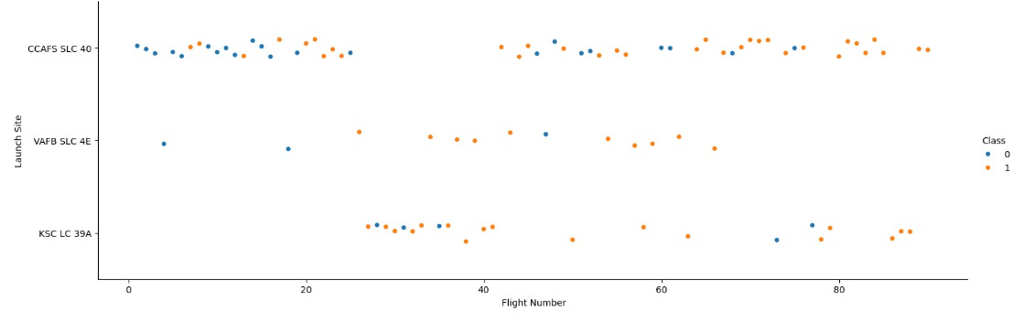
Flight Number vs. Launch Site
CCAFS SLC 40 had the most launches by a large margin. For all launch sites the number of successes increased as the number of flights increased

Slide 22
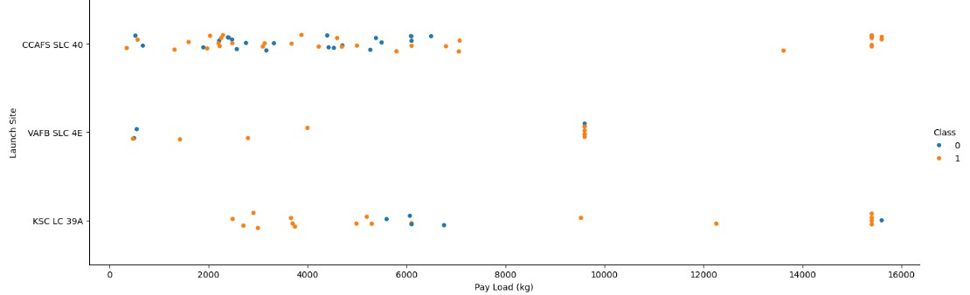
Payload vs. Launch Site
Most of the launches had a payload of under 10,000 kg, with Launch Sites VAFB SLC 4E and KSC LC 39A having high success rates. Launch Site CCAFS SLC 40 showed mixed results for launches with payloads between 0 kg and 8,000 kg, with greater success at higher payloads. VAFB SLC 4E had no launches above 10,000 kg.

Slide 23
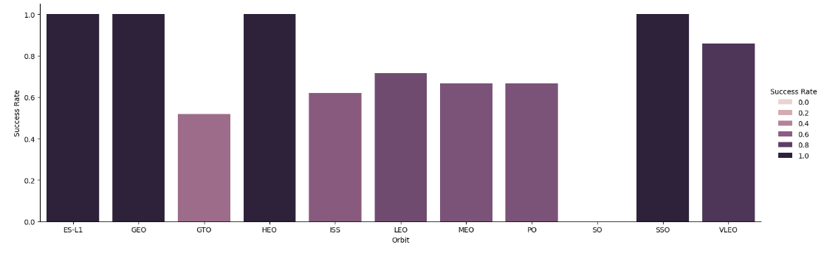
Success Rate vs. Orbit Type
The program distinguishes between 11 different orbits. Four orbits, ES-L1, GEO, HEO, and SSO have consistently high success rates. Based on the data Orbit Type has an important impact on successful launches

Slide 24
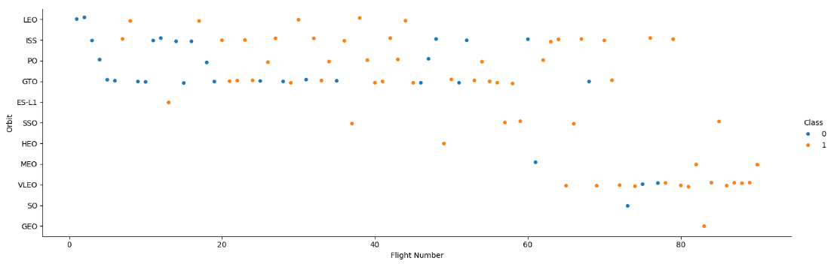
Flight Number vs. Orbit Type
This plot shows a overall higher success rate as the number of flights has increased. LEO,ISS and VLEO orbits have shown a visible improvement. GTO is an exception showing no meaningful improvement as flight numbers increase

Slide 25
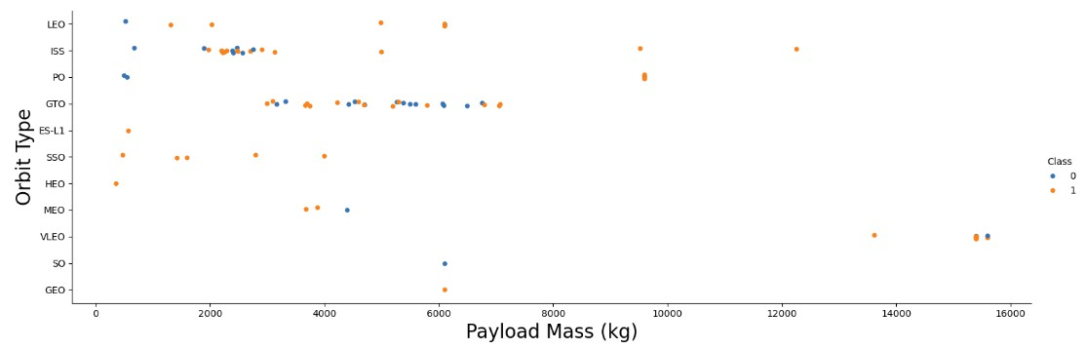
Payload vs. Orbit Type
As payload increases success rate increase for orbits, LEO, ISS. For payload values below 5,000 kg SSO has a high success rate. GTO again stands out as it is difficult to
distinguish between success and failure.

Slide 26
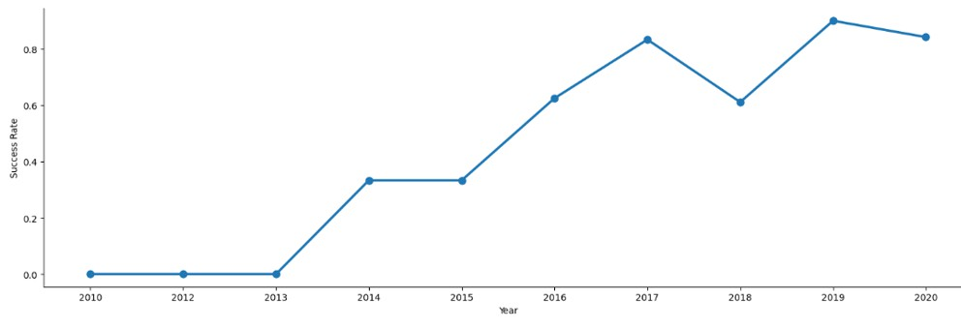
Launch Success Yearly Trend
Annual average launch success has a shown consistent improvement over the decade shown on the chart. This is a positive trend for the evolution of the launch program.
26

Slide 27
All Launch Site Names
Unique Launch Sites:
unique_launch_site = "SELECT DISTINCT Launch_Site FROM SPACEXTBL;“
launch_site_names = pd.read_sql(unique_launch_site, con)
Launch Site Names
CCAFS LC-40
VAFB SLC-4E
KSC LC-39A
3 CCAFS SLC-40
query selects a list of DISTINCT launch site names from the table SPACEXTBL
Create a pandas dataframe launch_site_names and connects to “my_data1.db” as ‘unique
_launch_site’

Slide 28
Launch Site Names Begin with 'CCA'
Display CCA Launch sites:
CCA_launch_site = "SELECT * FROM SPACEXTBL WHERE Launch_Site LIKE 'CCA%' LIMIT 5;“
CCA_site_names = pd.read_sql(CCA_launch_site, con)
Date Time (UTC) Booster_Version Launch_Site \ Payload PAYLOAD_MASS KG_ \ Orbit Customer Mission_Outcome
Landing_Outcome
0 | 2010-06-04 | 18:45:00 F9 v1.0 B0003 | CCAFS LC-40 | Dragon Spacecraft... | 0 | LEO | SpaceX | Success | Failure (parachute)
1 | 2010-12-08 | 15:43:00 F9 v1.0 B0004 | CCAFS LC-40 | Dragon demo flight C1... | 0 | LEO (ISS) | NASA (COTS) NRO | Success | Failure (parachute)
2 | 2012-05-22 | 7:44:00 F9 v1.0 B0005 | CCAFS LC-40 | Dragon demo flight C2 | 525 | LEO (ISS) | NASA (COTS) | Success | No attempt
3 | 2012-10-08 | 0:35:00 F9 v1.0 B0006 | CCAFS LC-40 | SpaceX CRS-1 | 500 | LEO (ISS) | NASA (CRS) | Success | No attempt
4 | 2013-03-01 | 15:10:00 F9 v1.0 B0007 | CCAFS LC-40 | SpaceX CRS-2 | 677 | LEO (ISS) | NASA (CRS) | Success | No attempt
Query selects all info from table SPACEXTBL where the launch site begins with the letters ‘CCA’
and shows the first five lines
Create a pandas dataframe CCA_site_names and connects to “my_database1.db” as CCA_launc h_site

Slide 29
Total Payload Mass
Display Payload Mass for NASA launches:
NASA_payload_mass = "SELECT SUM(PAYLOAD_MASS KG_) AS Total_Payload_Mass FROM SPACEXTBL
WHERE Customer LIKE '%NASA (CRS)%’;”
NASA_payload = pd.read_sql(NASA_payload_mass, con)
Total_Payload_Mass
0 48213
Query selects the sum of payload mass and assigns alias ‘Total_Payload_Mass’, from table SPACEXTBL where the customer is ‘NASA’
Create a pandas dataframe ‘NASA_payload’ and connects to “my_database1.db” as
‘NASA_payload_mass’

Slide 30
Average Payload Mass by F9 v1.1
Display Average Payload Mass for Booster Version F9:
AVG_payload_massF9 = "SELECT AVG(PAYLOAD_MASS KG_) AS Avg_Payload_Mass FROM SPACEXTBL
WHERE Booster_Version = 'F9 v1.1’;”
AVG_massF9 = pd.read_sql(AVG_payload_massF9, con)
Avg_Payload_Mass
0 2928.4
Query selects the average payload mass and assigns alias ‘Avg_Payload_Mass’, from table SPACEXTBL where the Booster Version is ‘F9 v1.1’
Create a pandas dataframe ‘AVG_mass_F9’ and connects to “my_database1.db” as ‘AVG_payload_massF9’

Slide 31
First Successful Ground Landing Date
Dates for successful ground pad landings:
first_succ_land_date = "SELECT MIN(Date) AS First_Successful_Landing FROM SPACEXTBL WHERE
Landing_Outcome = 'Success (ground pad)’;”
succ_land_date = pd.read_sql(first_succ_land_date, con)
First_Successful_Landing
0 2015-12-22
Query selects the first (min) date and assigns alias ‘First_Successful_Landing’, from table SPACEXTBL
where the landing outcome for a ground pad was successful
Create a pandas dataframe ‘succ_land_date’ and connects to “my_database1.db” bas ‘first_succ_land_date’

Slide 32
Successful Drone Ship Landing with Payload between 4000 and 6000
Boosters with success in drone ship and payload between 4000 and 6000 kg:
successful_booster_4000 = "
SELECT Booster_Version FROM SPACEXTBL WHERE Landing_Outcome = 'Success (drone ship)’
AND PAYLOAD_MASS KG_ BETWEEN 4000 AND 6000; "
succ_boost_4000_6000 = pd.read_sql(successful_booster_4000, con)
Booster_Version
0 F9 FT B1022
1 F9 FT B1026
2 F9 FT B1021.2
3 F9 FT B1031.2
Query selects Booster Version from table SPACEXTBL where the landing outcome for a drone ship, with a payload
between 4,000 kg and 6,000 kg, was successful
Create a pandas dataframe ‘succ_boost_4000_6000’ and connects to “my_database1.db” as ‘successful_booster_4000’

Slide 33
Total Number of Successful and Failure Mission Outcomes
Total number of successful and failed missions:
mission_success = "SELECT Mission_Outcome, COUNT(*) AS Count FROM SPACEXTBL GROUP BY Mission_Outcome;"
mission_succ_fail = pd.read_sql(mission_success, con)
Mission_Outcome | Count
0 Failure (in flight) | 1
1 Success | 98
2 Success | 1
3 Success (payload status unclear) | 1
Query selects the count of mission outcomes and groups them as success or failure and assigns to
alias ‘COUNT’, from table SPACEXTBL
Create a pandas dataframe ‘mission_succ_fail’ and connects to “my_database1.db” as ‘mission_success’

Slide 34
Boosters Carried Maximum Payload
List of Booster Versions Carrying the Maximum Payload Mass:
booster_payload_max = “ SELECT Booster_Version FROM SPACEXTBL WHERE PAYLOAD_MASS KG_ = (SELECT MAX(PAYLOAD_MASS KG_) FROM SPACEXTBL);"
booster_max_mass = pd.read_sql(booster_payload_max, con)
Booster_Version
0 F9 B5 B1048.4
1 F9 B5 B1049.4
2 F9 B5 B1051.3
3 F9 B5 B1056.4
4 F9 B5 B1048.5
5 F9 B5 B1051.4
6 F9 B5 B1049.5
7 F9 B5 B1060.2
8 F9 B5 B1058.3
9 F9 B5 B1051.6
Query selects the booster version from SPACEXTBL where the payload mass is a maximum value
Create a pandas dataframe ‘booster_max_mass’ and connects to “my_database1.db” as ‘booster_payload_max’
10 F9 B5 B1060.3
11 F9 B5 B1049.7

Slide 35
2015 Launch Records
List of Failure Landing Outcomes in Drone Ship, Booster Version and Launch Site –
By Month:
drone_landing_failure = "SELECT substr(Date, 6,2) AS Month, Landing_Outcome, Booster_Version, Launch_Site FROM SPACEXTBL
WHERE substr(Date, 0, 5) = '2015' AND Landing_Outcome = 'Failure (drone ship)';" drone_landing_outcomes = pd.read_sql(drone_landing_failure, con)
Month Landing_Outcome Booster_Version Launch_Site
0 01 | Failure (drone ship) | F9 v1.1 B1012 | CCAFS LC-40
1 04 | Failure (drone ship) | F9 v1.1 B1015 | CCAFS LC-40
Query selects landing outcome, booster version, and launch site and the month using substring (Date,6,2) and assigns alias Month to the substring, from SPACEXTBL where the year is 2015 and the landing outcome is a drone ship failure
Create a pandas dataframe ‘drone_landing_outcomes’ and connects to “my_database1.db” as ‘drone_landing_failure’

Slide 36
Rank Landing Outcomes Between 2010-06-04 and 2017-03-20
List Landing Outcomes Between 2010-6-04 and 2017-03-20:
rank_landing_outcomes = "SELECT Landing_Outcome, COUNT(*) AS Count FROM SPACEXTBL WHERE Date BETWEEN '2010-06-04' AND '2017-03-20’
GROUP BY Landing_Outcome ORDER BY Count DESC;" ranked_landing_04_20 = pd.read_sql(rank_landing_outcomes, con)
Landing_Outcome Count
0 No attempt 10
1 Success (drone ship) | 5
2 Failure (drone ship) | 5
3 Success (ground pad) | 3
4 Controlled (ocean) | 3
5 Uncontrolled (ocean) | 2
6 Failure (parachute) | 2
7 Precluded (drone ship) 1
Query selects the count of landing outcomes from SPACEXTBL and assigns alias ‘Count’, where the dates are between 2010-06-04 and groups them in descending order of landing outcomes
Create a pandas dataframe ‘drone_landing_outcomes’ and connects to “my_database1.db” as ‘drone_landing_failure’

Slide 37

Section 3

Slide 38
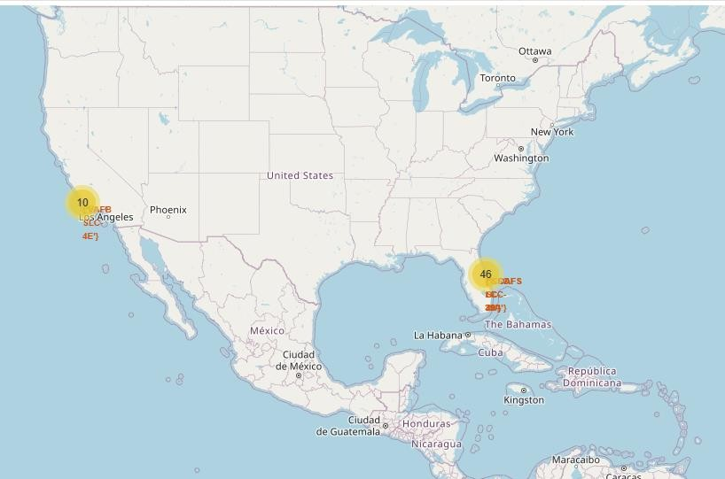
SpaceX US Launch Sites
The interactive map identifies the east and west coast launch sites used by SpaceX
The yellow cluster markers indicate the total number of flights launched from each location
On closer inspection the Florida marker represents two overlapping launch sites
The Florida site is clearly the favored launch location for SpaceX

Slide 39
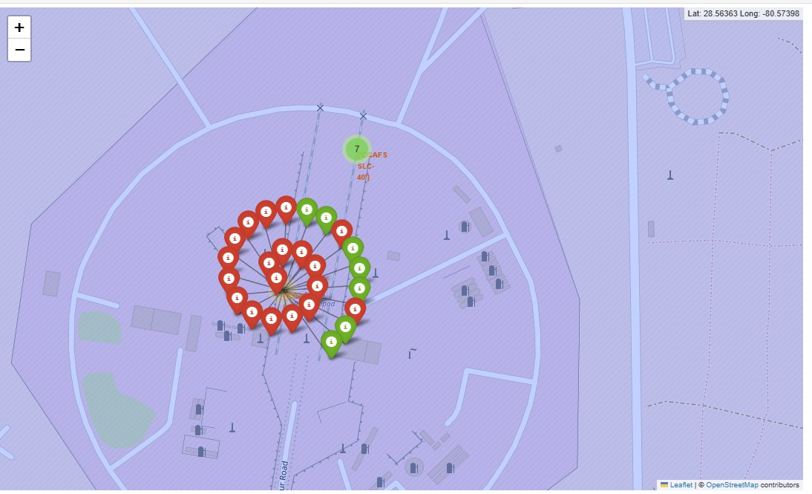
Successful SpaceX Launches from Site CCAFS SLC-40
The interactive map shows the outcomes for launches at site CCAF SLC-40, labeled by color
Green indicates a successful launch and red represents failed launches
Failed launches from this site outnumbered the successful launches by 3:1

Slide 40
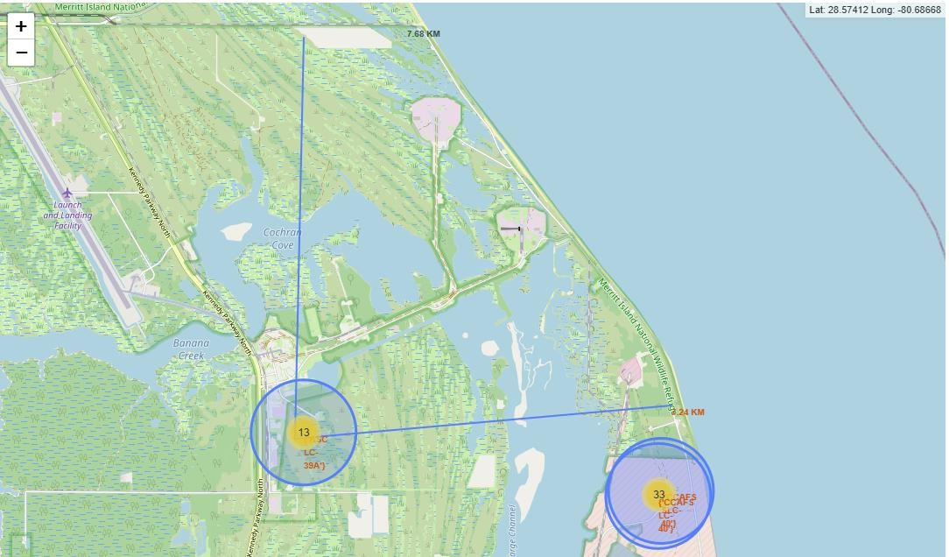
SpaceX Launch Site Proximity to Local Services
The interactive chart illustrates the distance from the launch sites to local transportation routes
The three Florida launch sites stand in close proximity to local roads and rail lines as well as the Atlantic ocean coastline
Further inspection reveals that the launch sites remain at safe distance to local cities

Slide 41

Section 4

Slide 42
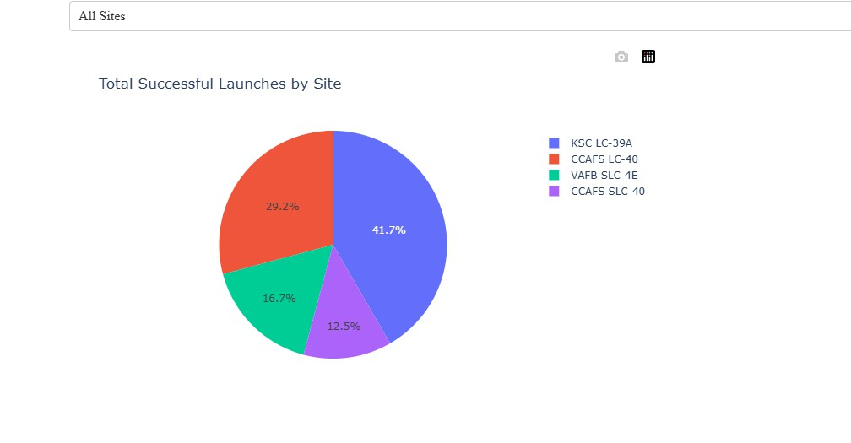
SpaceX Successful Launches by Launch Site
Florida location KSC LC-39A has a distinctively higher success rate at 41.7% followed by Site CCAF LC-40 with a 29.2% success rate

Slide 43
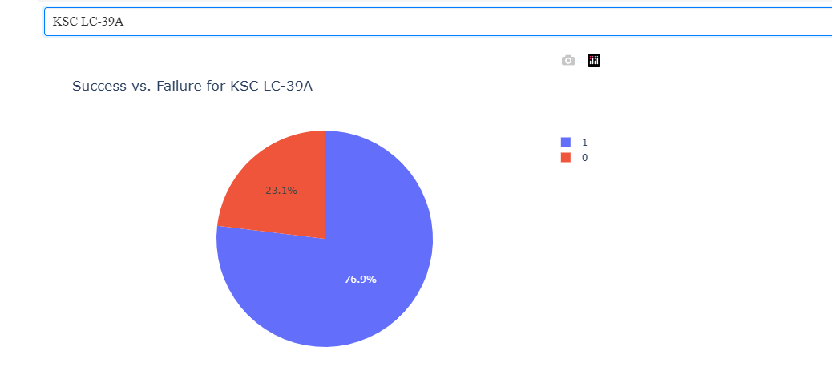
Success Rate for Launch Site KSC LC-39A
Launch site KSC LC-39A was the most successful launch site for SpaceX
This particular site had a 76.9% success rate
For reference neighboring site CCAFS LC-40 had the lowest success rate at 26.9%

Slide 44
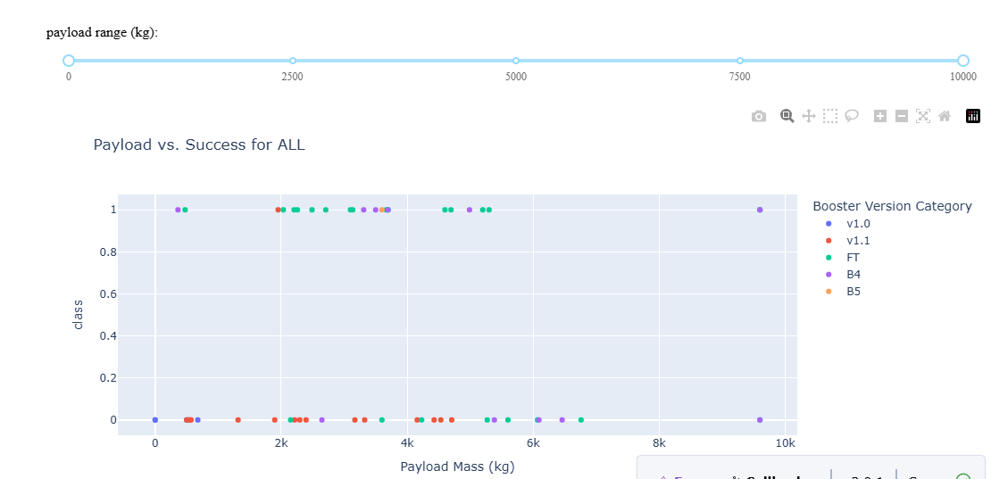
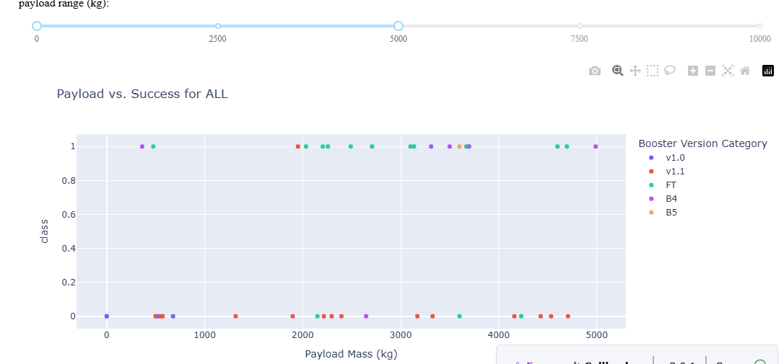
Launch Success for each Booster by Payload
Over the payload spectrum Booster FT has the highest launch success rate with most launches in the 2,000 kg to 5,000 kg payload range
By comparison Booster v1.1 had the most failures over the payload spectrum
Success above the 5,000 kg payload level were minimal.

Slide 45

Section 5

Slide 46
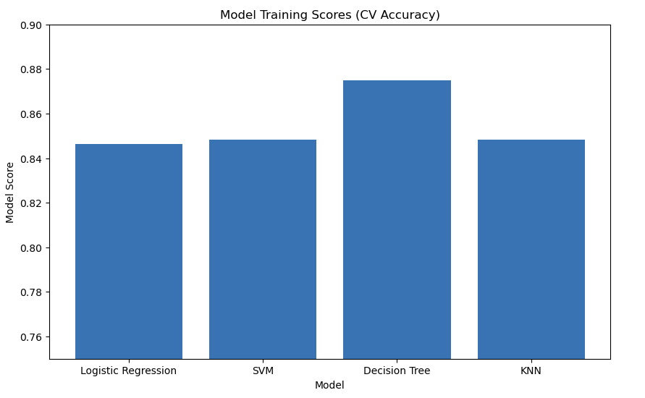
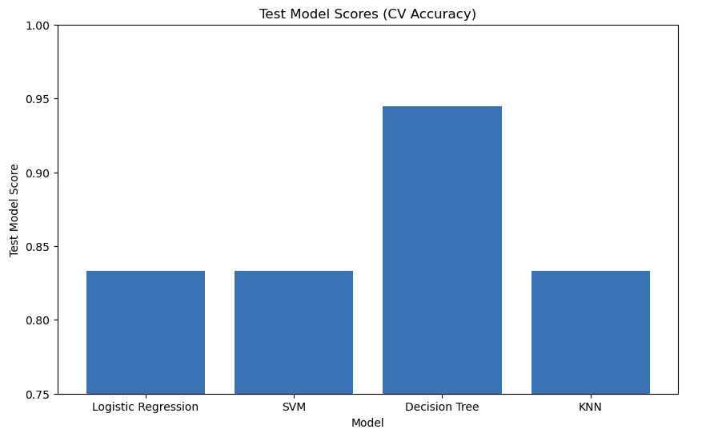
Classification Accuracy
The Decision Tree model has the highest classification accuracy on the test data of 0.875. Based on the scores there is little to choose from the other three models
This result is confirmed by the training data where the Decision Tree model accuracy outperformed the other three models

Slide 47
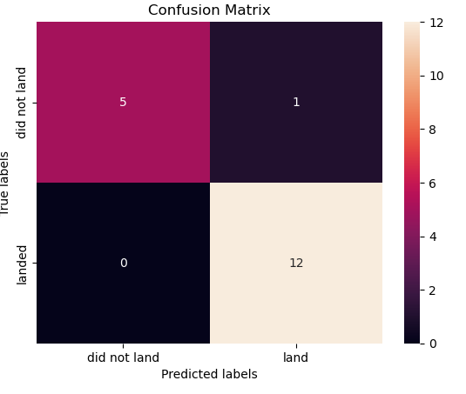
Confusion Matrix – Decision Tree Classifier
The Decision Tree Classifier proves to be the most accurate model
It predicted12 True Positive results, a prediction of true successful landings
and predicted only 1 False Positive, a false prediction of a successful landing

Slide 48
Conclusions
Booster Version FT has shown a consistent success rate as payload increases up to 6,000 kg with Booster Version v1.1 has the least success over the payload spectrum
Launch site KSC LC 39A has the highest percentage launch rate success while Launch site CCAFS SLC 40 has the highest absolute successes, but also the highest overall number of flights
Orbit VLEO has the highest success as one of the higher volume orbits used although Orbit GTO is the most used but with mixed success
ES-L1, HEO and GEO have had initial launch successes
The Decision Tree classification model yielded the highest level of accuracy on both training and test data
Reviewing the Confusion Matrix also shows that the Decision Tree model yielded the fewest false positives
Overall Conclusions:
The first stage rocket recovery has enhanced the success of the launch program
As flight numbers increase the likelihood of a successful outcome increases
Lower earth orbits have higher success rates
Generally lighter payloads have a better success rates

Slide 49
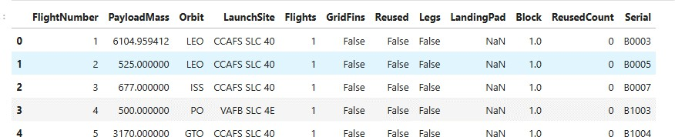
Appendix – Selected Features for Engineering

Slide 50
Appendix – Orbit Types
Each launch aims for a dedicated orbit, and here are some common orbit types:
LEO: Low Earth orbit (LEO)is an Earth-centred orbit with an altitude of 2,000 km (1,200 mi) or less (approximately one-third of the radius of Earth),[1] or with at least
11.25 periods per day (an orbital period of 128 minutes or less) and an eccentricity less than 0.25.[2] Most of the manmade objects in outer space are in LEO [1].
VLEO: Very Low Earth Orbits (VLEO) can be defined as the orbits with a mean altitude below 450 km. Operating in these orbits can provide a number of benefits to Earth observation spacecraft as the spacecraft operates closer to the observation[2].
GTO A geosynchronous orbit is a high Earth orbit that allows satellites to match Earth's rotation. Located at 22,236 miles (35,786 kilometers) above Earth's equator, this position is a valuable spot for monitoring weather, communications and surveillance. Because the satellite orbits at the same speed that the Earth is turning, the
satellite seems to stay in place over a single longitude, though it may drift north to south,” NASA wrote on its Earth Observatory website [3] .
SSO (or SO): It is a Sun-synchronous orbit also called a heliosynchronous orbit is a nearly polar orbit around a planet, in which the satellite passes over any given point of the planet's surface at the same local mean solar time [4] .
ES-L1 :At the Lagrange points the gravitational forces of the two large bodies cancel out in such a way that a small object placed in orbit there is in equilibrium relative to the center of mass of the large bodies. L1 is one such point between the sun and the earth [5] .
HEO A highly elliptical orbit, is an elliptic orbit with high eccentricity, usually referring to one around Earth [6].
•
ISS A modular space station (habitable artificial satellite) in low Earth orbit. It is a multinational collaborative project between five participating space agencies: NASA (United States), Roscosmos (Russia), JAXA (Japan), ESA (Europe), and CSA (Canada) [7]
MEO Geocentric orbits ranging in altitude from 2,000 km (1,200 mi) to just below geosynchronous orbit at 35,786 kilometers (22,236 mi). Also known as an intermediate circular orbit. These are "most commonly at 20,200 kilometers (12,600 mi), or 20,650 kilometers (12,830 mi), with an orbital period of 12 hours [8]
HEO Geocentric orbits above the altitude of geosynchronous orbit (35,786 km or 22,236 mi) [9]
•
GEO It is a circular geosynchronous orbit 35,786 kilometres (22,236 miles) above Earth's equator and following the direction of Earth's rotation [10]
PO It is one type of satellites in which a satellite passes above or nearly above both poles of the body being orbited (usually a planet such as the Earth [11]

Slide 51
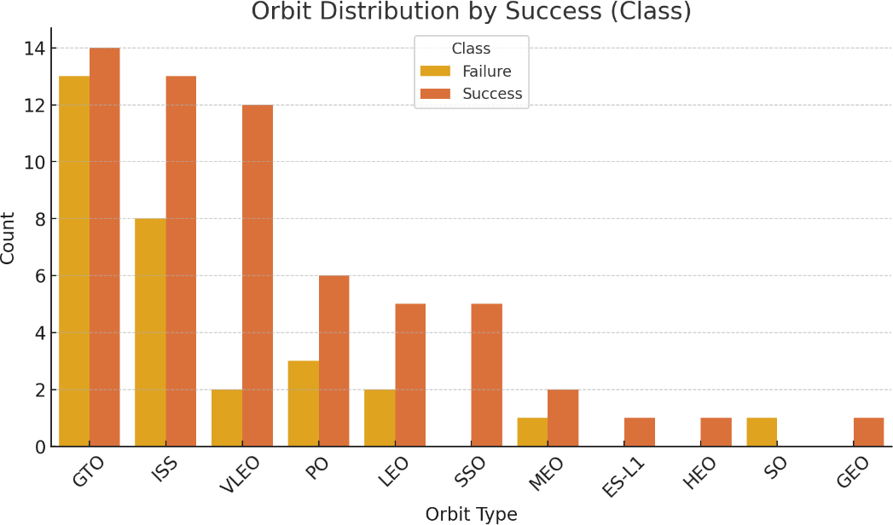
Appendix – Success by Orbit
Orbit appears to a have a strong bearing on mission success rates
ES-L1, HEO and GEO have initial success rates
VLEO has the highest success rate for frequently used orbits

Slide 52
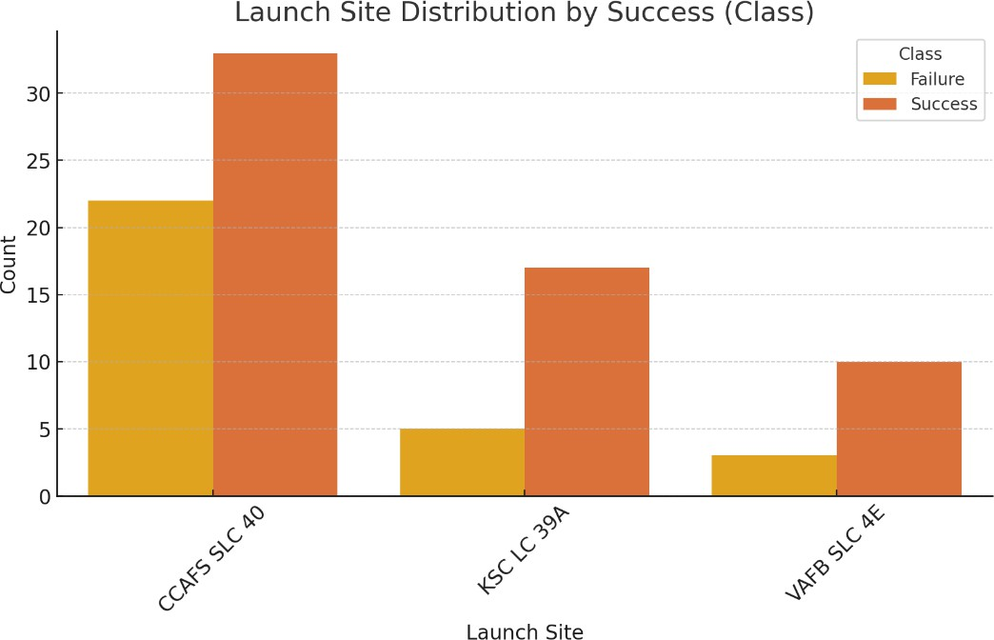
Appendix – Success by Launch Site
CCAFS SLC 40 was the most used launch site with a 57.1% success rate
KSC LC 39A was the most successful site with a 76.9% success rate
VAFB SLC 4E followed with a 60% success rate on a lower number of launches

Slide 53
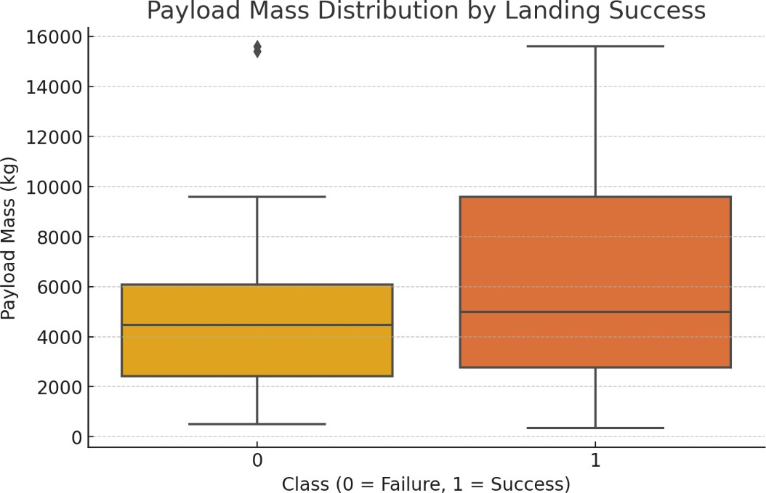
Appendix – Landing Success by Payload Mass
Successful missions occurred over a broad range of payloads, with a majority under 10,000 kg
The median load on successful missions was around 5,000 kg
Unsuccessful missions occurred over a narrower payload range

Slide 54
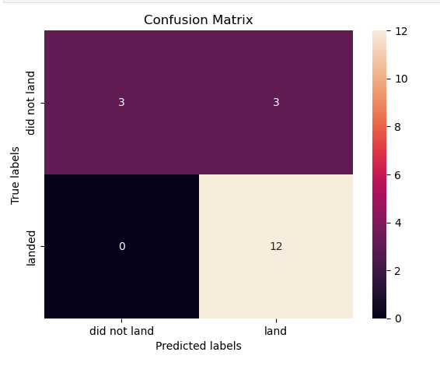
Appendix – Confusion Matrix Success Comparison
Decision Tree Classifier
The Confusion Matrix for the Decision Tree Classifier confirms its best model accuracy with 12 True Positive results and only 1 False Positive
The confusion matrix on the right is identical for the other three classifiers and while showing 12 True Positives it also reveals 3 False Positives
54

Slide 55


